Slide 1

Turning data into wisdom
Notes:
I’m Or and I’m the CTO of Munimatrix.
Let me tell you a short story about our CEO Isaac, he works at Kiryat Yam municipality.
They got a budget for bomb shelters, and his division needed to know where to place those bomb shelters.
They were out of clue.
They didn’t know who are the citizens that don’t have bomb shelters.

Slide 2

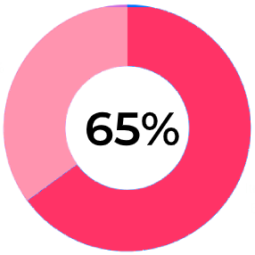


The Problem
Municipalities:
Facing challenges to understand citizens needs.
Underutilize data.
Traditional, respond to unexpected issues.
Incurring expenses on redundant or unexpected projects.
Notes:
65% of municipalities in Israel are currently in deficit.
Municipalities struggle to understand their citizens needs.
They have so much potential with their data but often underutilize it.
They are traditional and mostly reactive response to issues rather than planning forward.
Thus results with a lot of money spent on unneeded projects or solving unexpected issues which is more expensive.

Slide 3

Market Size
01
Target Market
Mid tier (4-7) Israeli municipalities in digilocal index of Deloitte.
02
16M$
Served Available Market
All Israeli municipalities.
34M$
03
Total Available Market
Europe and Northern America (USA, Canada) municipalities..
28B$
Notes:
Our target market is based on digilocal index of Deloitte, this index shows which municipalities in Israel adopt digital services to their citizens.
We plan to go on mid tier, because we believe they are more likely than low tier and high tier to use our product.
Then we plan to reach all Israeli municipalities and afterward we plan to expand to other western countries.

Slide 4
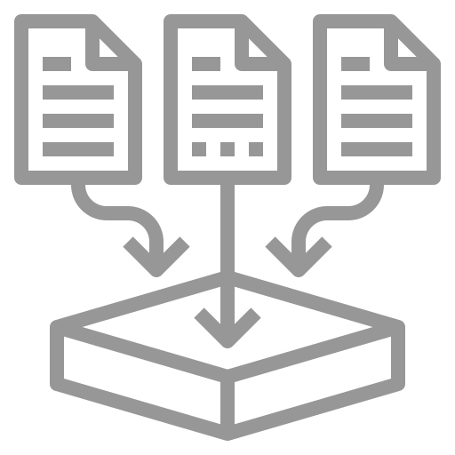





The Solution
Municipality data collection
Data warehouse creation
Platform for users
Understand citizens needs
Plan proactively projects
Reduce costs
Notes:
We start with municipality data collection, we build data pipelines to migrate the data to a data warehouse.
On top of the data warehouse we will build a user friendly platform with dashboards, reports, data analysis, machine learning model predictions and AI insights.
The platform will help muncipialiity understand their citizens needs and plan future projects and this will reduce costs and save money.

Slide 5


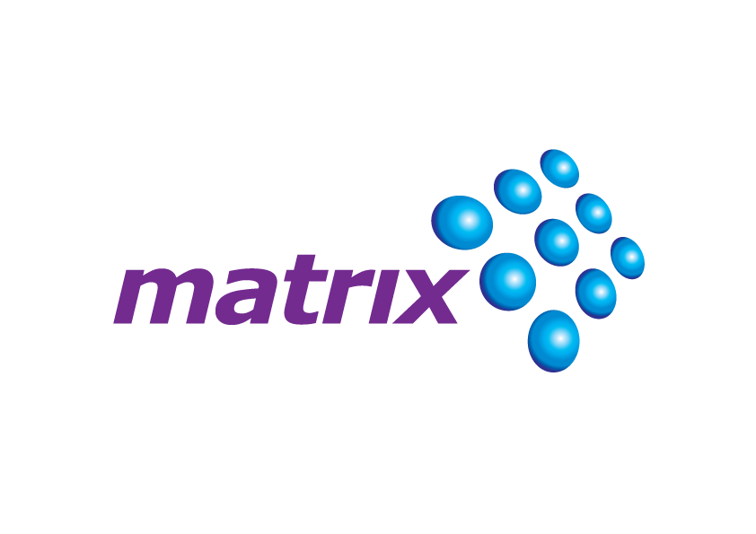






Competitive Landscape
Highly Customized
Private Sector Focus
Public Sector Focus
Off-the-Shelf Product

Slide 6




Competitive Advantage
Cost effective decision making Helping municipality to plan based on data and reduce costs.
Customization Tailor made for specific municipality.
Expertise
Only product in the market 100% dedicated to municipalities.
User friendly platform Every municipality employee can use it.
Notes:
Competitive Differentiation:
Product Functions and Features: MuniMatrix offers deep data integration and advanced forecasting capabilities, enabling municipalities to proactively prioritize tasks and make informed decisions.
Customization Options: MuniMatrix can tailor solutions to specific urban needs and seamlessly integrate with existing systems, ensuring a customized fit for each client.
Expertise: Our team combines data analytics professionals with municipal government specialists, resulting in deep expertise in tackling urban challenges.
Market Leadership Potential: By focusing on the public sector, MuniMatrix is well-positioned to become a leading player in this specific market.
Strong Brand Recognition: Our established reputation within the municipal sector attracts new clients seeking innovative solutions.
Cost-effective Decision Making: MuniMatrix automates data analysis and generates actionable insights, potentially reducing costs and saving resources for local authorities.
User-friendly Platform: Our intuitive platform and comprehensive training encourage wider adoption, building a strong customer base.
Strategic Partnerships: MuniMatrix collaborates with a diverse network of public and private sector organizations, enhancing our reach and service delivery.

Slide 7
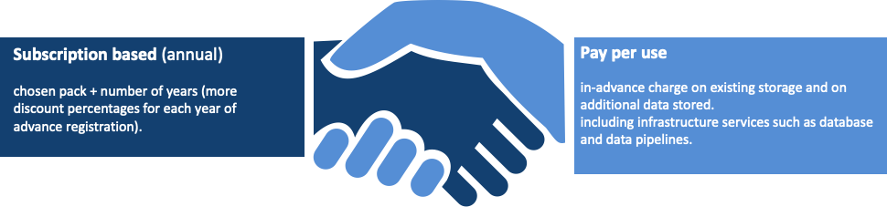
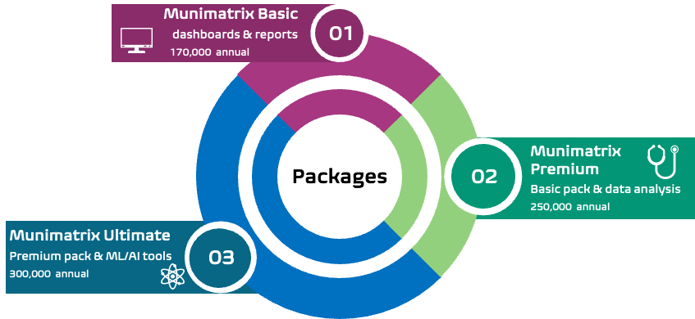
Our Business Strategy

Slide 8






Our Team
Isaac Tsalik
CEO
Ofir Mor
CMO
Shalev Alkaher
CFO
Or Yagol
CTO
Snir Akons
CSO
Elchai Refoua
CPO

Slide 9

Our Need
Analysts & developers salary
130K$ Annual
Founders salary
60K$ Annual
Infrastructures (Cloud, ETL, Databases, GPT4)
14K$ Annual
Microsoft utilities, code editors, GitHub
3K$ Annual
212.5K$ for Pilot with 4 municipalities.
1 Year of development and implementation period.
Workspace & office utilities
5.5K$ Annual

Slide 10
Cities are where dreams are made, and futures are forged – Teju Cole

Slide 11

isaac.t@munimatrix.com

